Slide 1
Programming II
(C Programming Language)
Decision Making in C
(Part II)
Lecture 6, Wednesday February 10, 2021
Dr. Ayman ALJARBOUH

Slide 2
Outline
Decision Making with switch
Nested switch Statement
switch Statement

Slide 3
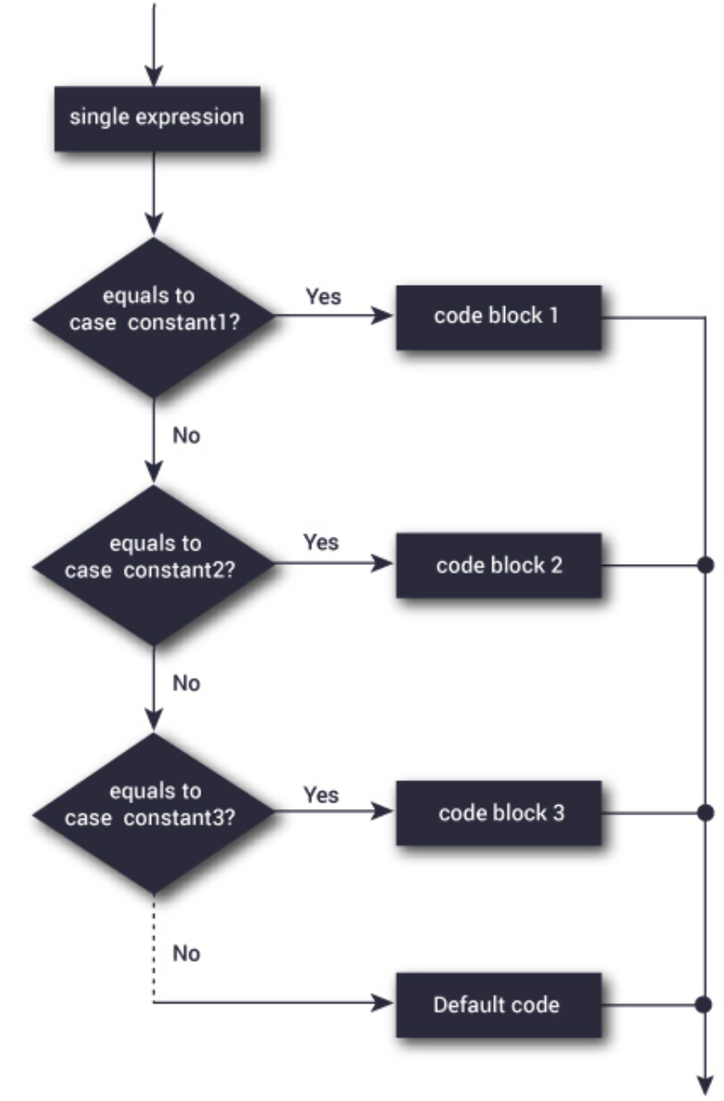
Decision Making with switch
We use switch case to make the C program user-friendly
The switch case allows giving more than two alternatives to choose from rather than just one or two
Switch Case structure

Slide 4
Outline
Decision Making with switch
Nested switch Statement
switch Statement

Slide 5
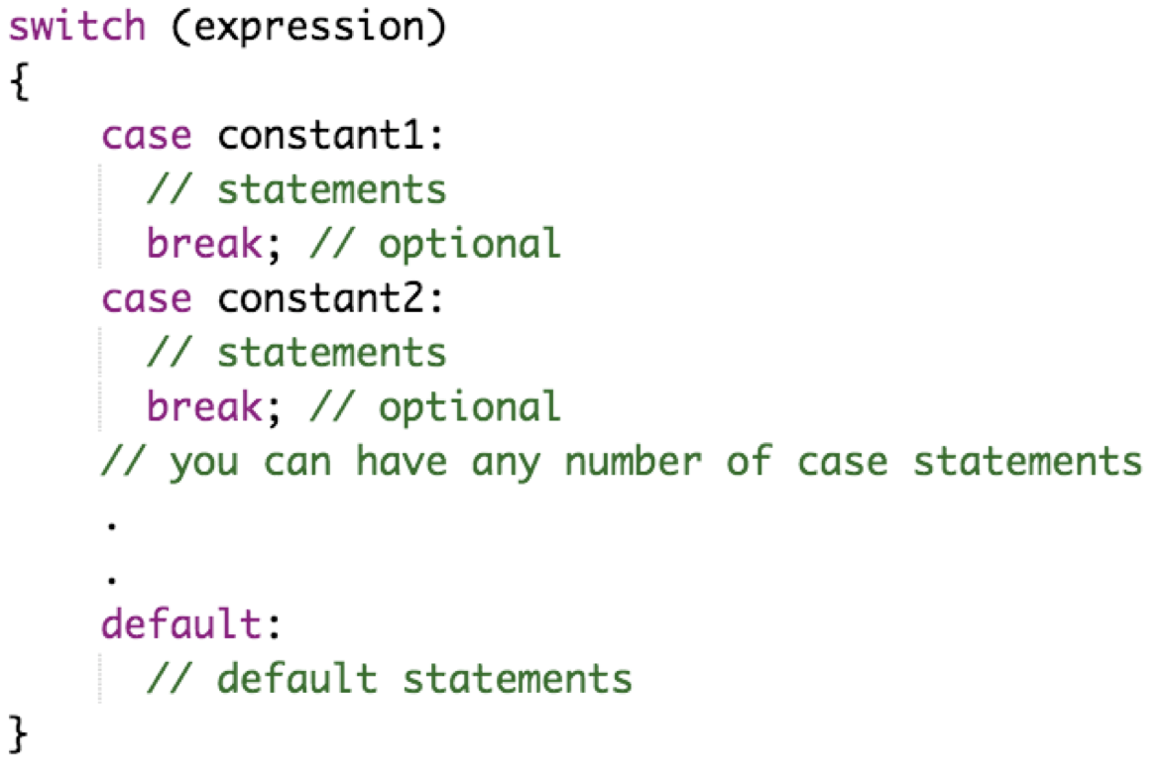
switch Statement
A switch statement allows a variable to be tested for equality against a list of values. Each value is called a case. The syntax is:
The expression is evaluated once, and compared with the values of each case label

Slide 6
switch Statement
A switch statement allows a variable to be tested for equality against a list of values. Each value is called a case. The syntax is:
If there is a match, the corresponding statements after the matching label are executed until break is encountered

Slide 7
switch Statement
A switch statement allows a variable to be tested for equality against a list of values. Each value is called a case. The syntax is:
The break ends the switch statement immediately when it is encountered. If we do not use break, all statements after the matching label are executed

Slide 8
switch Statement
A switch statement allows a variable to be tested for equality against a list of values. Each value is called a case. The syntax is:
If there is no match, the default statements are executed. The default clause inside the switch statement is optional

Slide 9
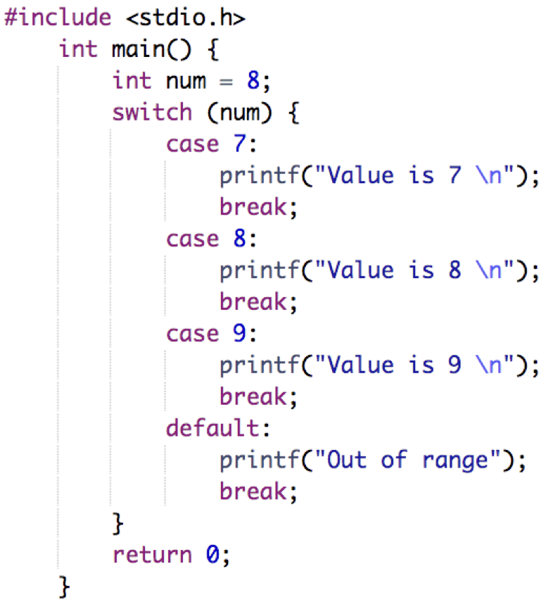
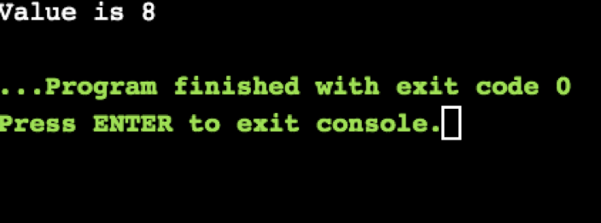
switch Statement
Output:
Example:

Slide 10
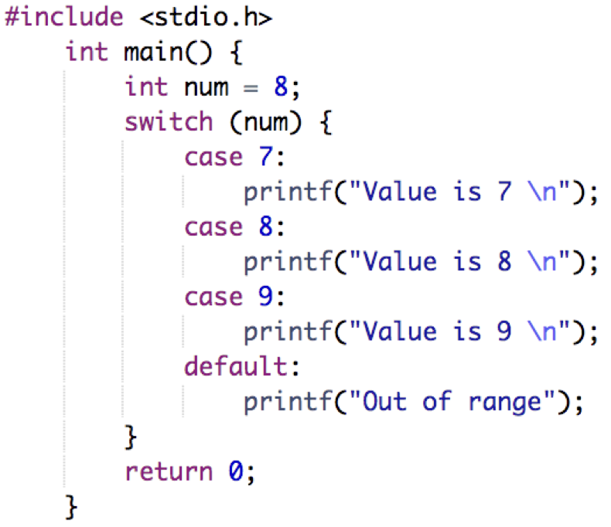
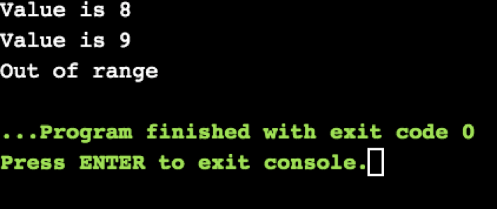
switch Statement
Output:
Example:

Slide 11
Outline
Decision Making with switch
Nested switch Statement
switch Statement

Slide 12
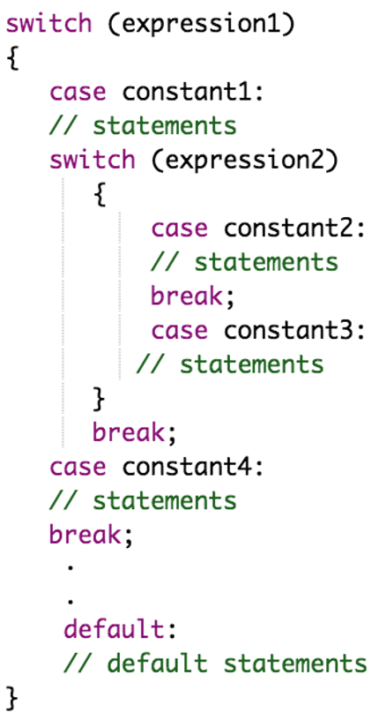
Nested switch Statement
It is possible to have a switch as part of the statement sequence of an outer switch. The syntax is:

Slide 13
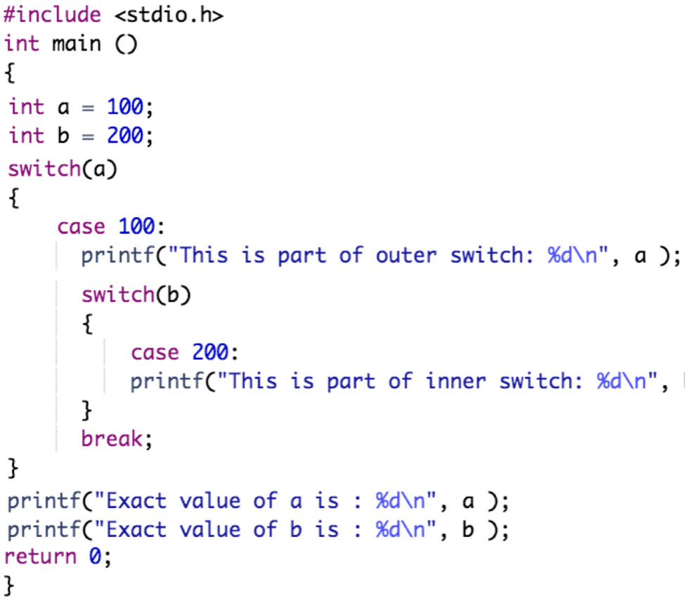
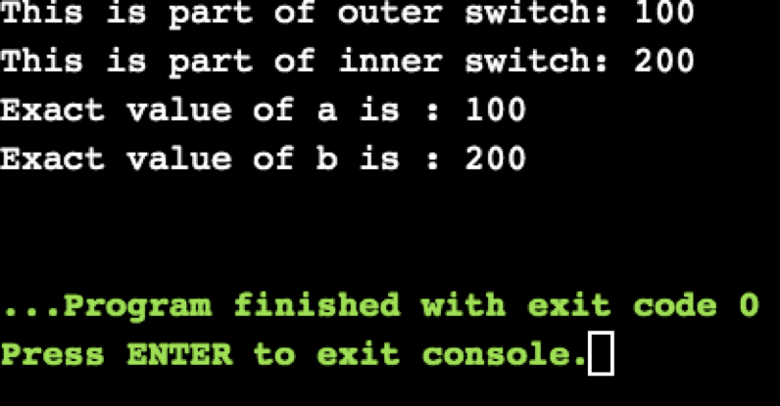
Nested switch Statement
Output:
Example:

Slide 14

Practical Exercises
Write and Compile the following C programs:
Program 1:

Slide 15
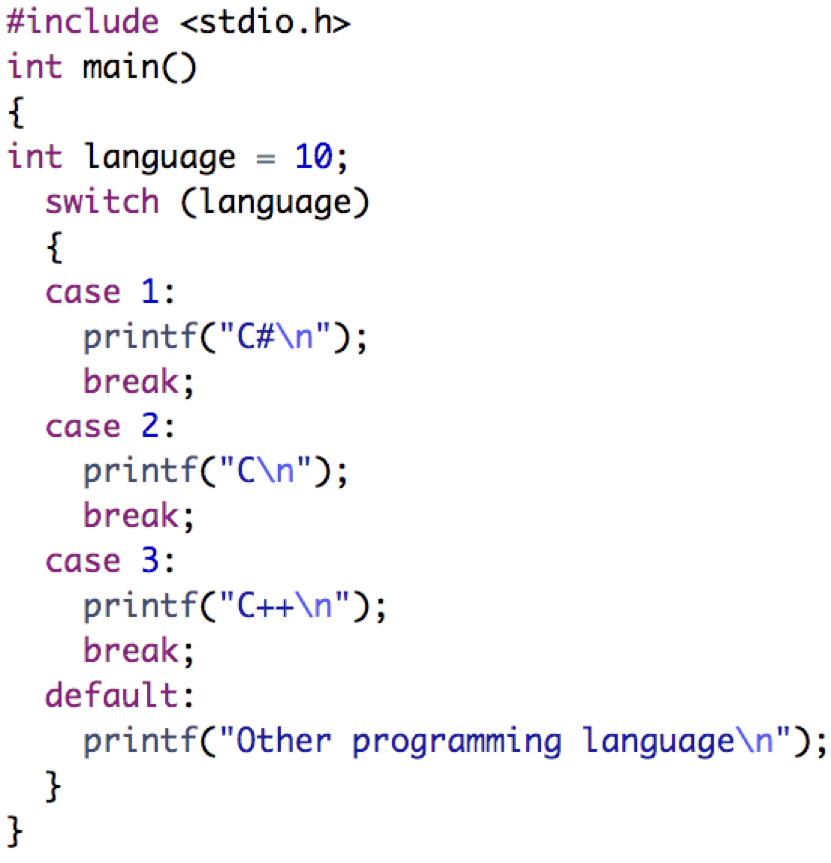
Practical Exercises
Write and Compile the following C programs:
Program 2:

Slide 16
Practical Exercises
Write and Compile the following C programs:
Program 3:

Slide 17
Practical Exercises
Write and Compile the following C programs:
Program 4:

